Slide 1

Coal Exploration Data Integrity and Management
Brett Larkin
GeoCheck Pty. Ltd.
brett@geocheck.com.au

Slide 2
Coal in the ground principal asset
True size of asset only known once mined
Investment decisions based on resource estimate derived from exploration database
Its real asset therefore is its data
How is this asset being managed ?

Slide 3
Exploration data can be divided into:
Observational data (survey, geology, geophysics, lab results)
Interpretational data (geophysical filtering, depth adjustment to geophysics, seam naming)

Slide 4
These can further be subdivided into:
Raw observational
Working observational
Finalized observational
Working interpretational
“Semi” Finalized interpretational
Each of these have specific requirements to ensure good data integrity and management

Slide 5
Requirements for Raw Observational Data
Coring appropriate intervals
Achieving required core recoveries (> 95%)
Good reconciliation of geologist’s & driller’s depths
Appropriate sampling (stone bands & sub plies)
Consistent geological logging (training and coding system, CoalLog)
No summary data such as RQD
Quality core photos
Consistent geological & geophysical zero depths

Slide 6
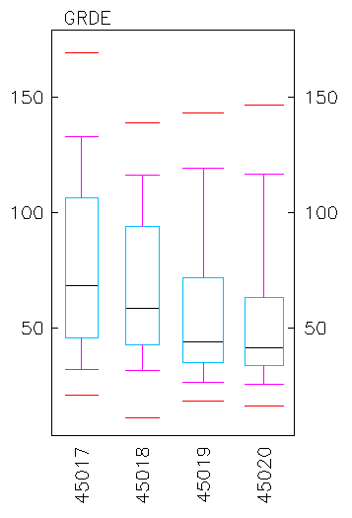
Requirements for Raw Observational Data
Timely, well-calibrated
geophysical logging

Slide 7
Requirements for Raw Observational Data
Preservation and backup of raw observational data including:
a) Hand-written coding sheets
b) Data collected on tablets
c) Unprocessed and unfiltered geophysical data

Slide 8
Requirements for Working Observational Data
Checks for invalid items, (invalid codes & out of range numerical values)
Valid codes and ranges can only be set by database manager
Double keying of hand-written data
Checks for compulsory data (holename, depths, lithotype, sample numbers)
Check invalid combinations (depths, %’s, qualifiers)
Appropriate Backup

Slide 9
Requirements for Finalized Observational Data
Ensure all data for the project has consistent format (layout, dictionaries etc)
Ensure no missing data (holes, geological, geophysical, analytical)
Checks for incorrect data (hole coordinates)
Ensure data can be exported to all software that may require it
Editing restricted to database manager
System for logging any changes to finalized data
Appropriate Backup

Slide 10
Requirements for Working Interpretational Data
Appropriate and consistent filtering and manipulation of geophysical data
Appropriate and consistent depth adjustment
Appropriate and consistent seam and ply nomenclature (variety of ways that plies are used)
Editing limited to Estimator and Database Manager
Appropriate Backup

Slide 11
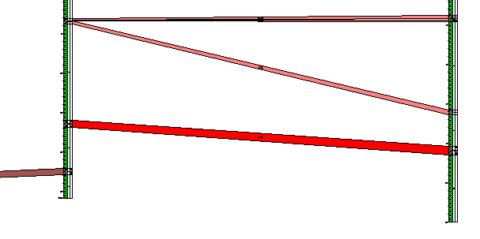
Requirements for Seam & Ply Nomenclature
Seams & plies are in stratigraphic order, keeping in mind reverse faulting
All significant coal intersections are named with a seam and possibly ply
Their variation in thickness makes sense
They make sense on graphic sections:

Slide 12
“Semi” Finalized Interpretational Data
There is no such thing as absolutely finalized interpretational data as interpretational data will often change from the time of initial exploration through until the time mining is completed.
At most, interpretational data can be deemed as finalized for the purposes of undertaking a particular study.
A copy of the interpretational data needs to be preserved as an addendum to the study.

Slide 13
Conclusion
The methods for ensuring data integrity and good management of coal exploration data depends on whether it is observational or interpretational data and what stage of the data collection process it is at.
Copies of this presentation can be downloaded from our the downloads page of our website at:
www.geocheck.com.au

